Slide 1
Metro Ridership Analysis
Analyzing trends of Washington D.C.’s Metro System
By Eyong Defang, Nicolas Lizarralde

Slide 2
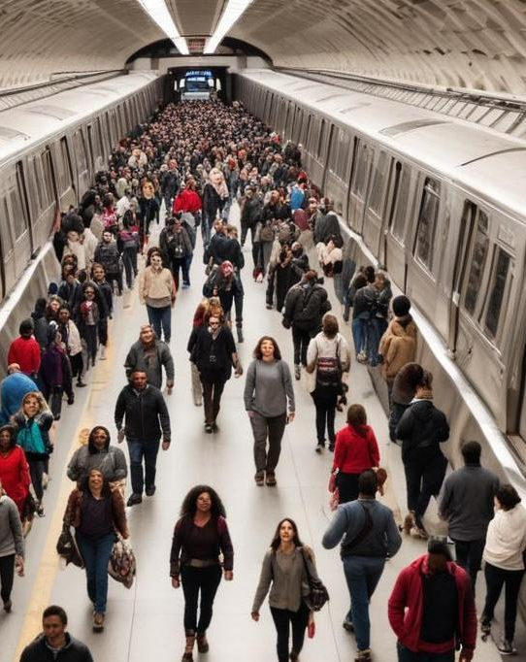
Introduction
This presentation explores the analysis of ridership trends in Washington D.C.'s Metro system using R programming. We will discuss the data overview and the methods used for visualization and analysis.

Slide 3
01
Data Overview

Slide 4
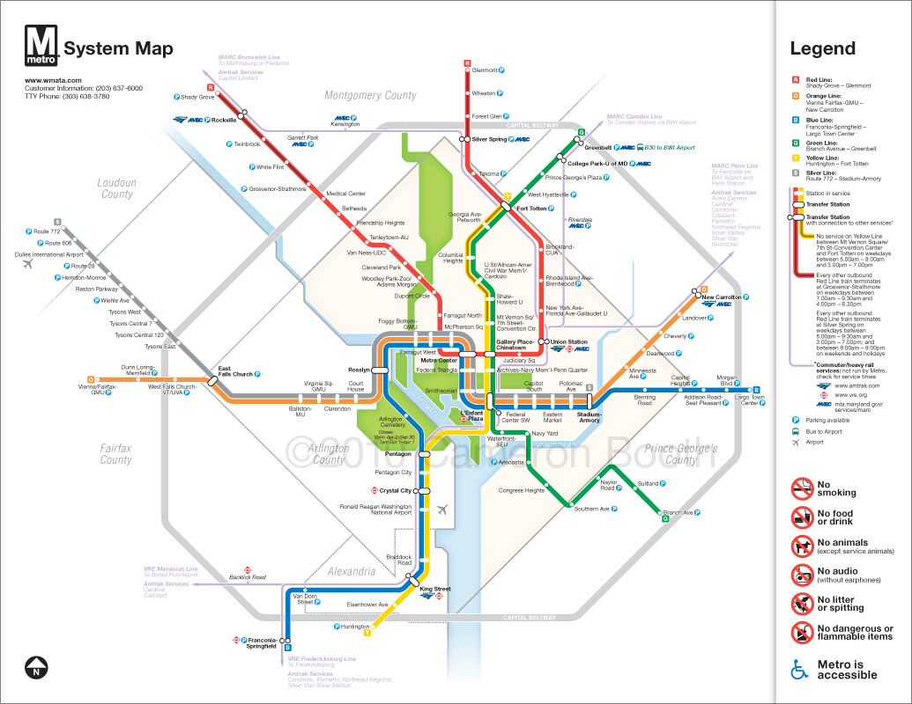
Metro System Description
Washington D.C.'s Metro system serves as a vital public transportation option, connecting various neighborhoods and key attractions. In our analysis, we focus on understanding usage patterns and overall trends to enhance operational efficiency.

Slide 5
Selected Date Range
The analysis covers eight specific dates, chosen to represent ridership across different seasons and events. The selected dates are December 4, December 21, June 5, June 15, March 6, March 23, September 4, and September 21 of 2024, allowing for a comprehensive examination of ridership fluctuations.

Slide 6
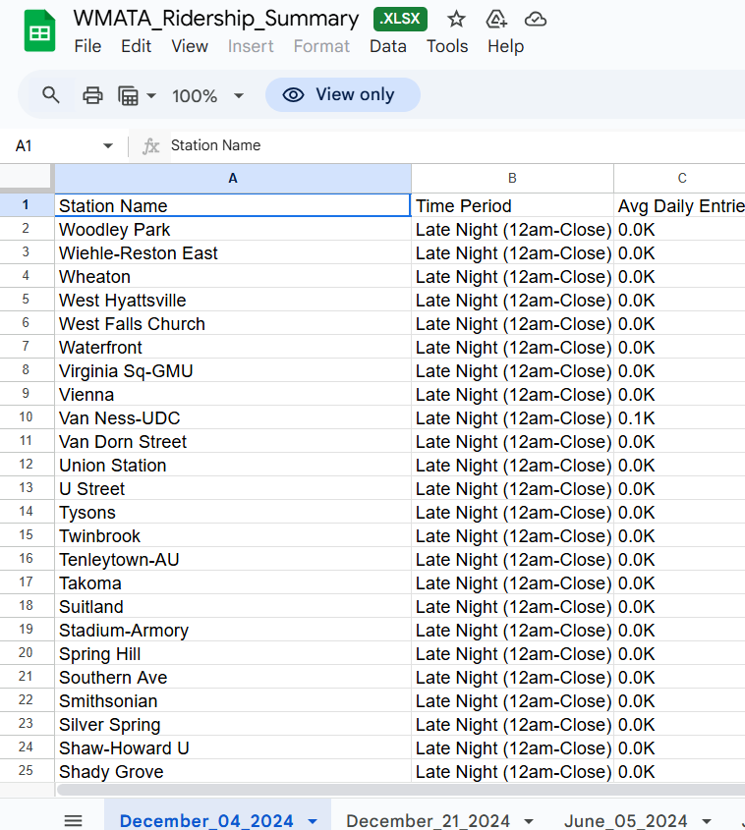
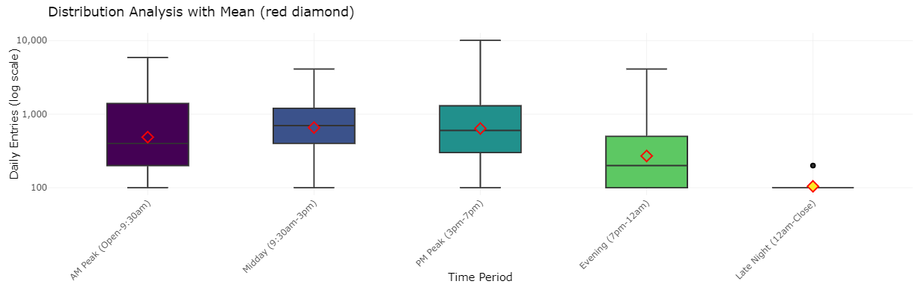
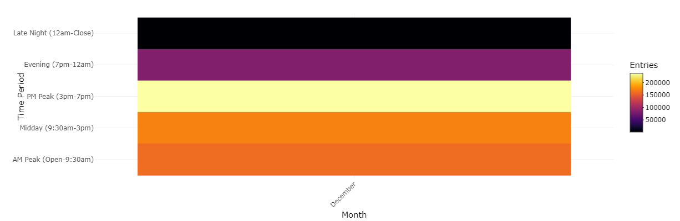
Data Collection Methods
Data for the analysis was provided by Mindpetal in a .xlsx file, which was then reorganized into a .csv for visualization and analysis through the use of R.

Slide 7
02
R Programming Analysis

Slide 8

Data Processing Techniques
R programming facilitated extensive data manipulation, including cleaning and organizing raw ridership data. Operations were performed using packages such as broom and viridis, enabling the team to prepare visualizations accurately that illustrate trends across the dates under review.

Slide 9
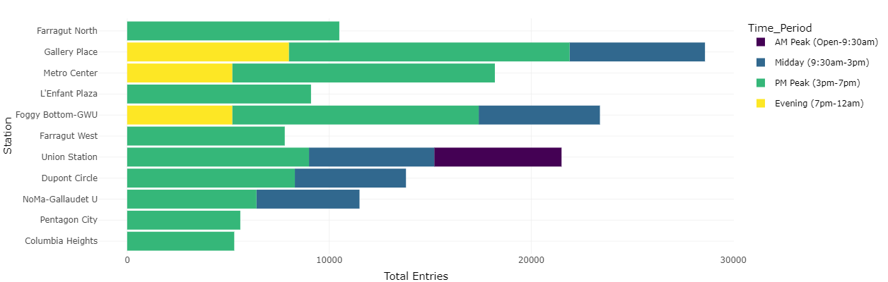
Visualization Tools Used
The analysis employed various visualization packages in R, notably ggplot2, for creating compelling visual representations of the data. The team generated graphs such as box plots and bar charts to visualize ridership trends over time for the different dates analyzed, thereby making complex data more understandable.

Slide 10
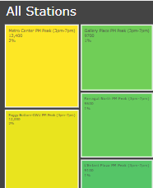
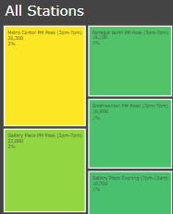
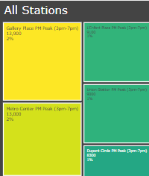
Insights Gained from Analysis
Whereas Metro Center was the most frequented station in Spring and Fall, Gallery Place was the most frequented station in Winter. This can be attributed to tourism increases, a decrease in COVID-19 cases and, in the case of the shift from Metro Center to Gallery Place in Winter, construction at certain stations.
Fall
Spring
Winter

Slide 11
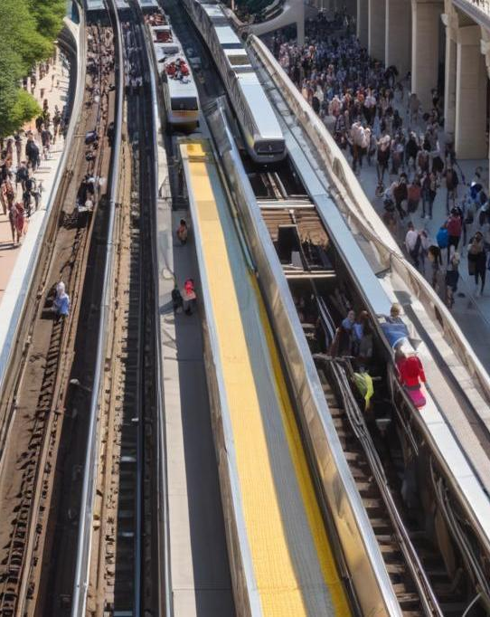
Conclusions
We were able to learn that ridership numbers can be heavily impacted by external factors such as disease, tourism-induced foot traffic, and construction. The latter two should be taken into special consideration when formulating city-wide plans to reduce subway congestion, since they are more easily controlled by laws and regulations.

Slide 12
Thank you!
Do you have any questions?
+91 620 421 838

